Slide 1
PERCEPTION
Meaning, Model of Perceptual process. Emotions in work place, Types of emotions, Circumplex Model of Emotion, Attitudes and Behaviour, Work-related stress and its management.

Slide 2
PERCEPTION : Meaning & Definition
According to Stephen P Robbins, “A process by which individuals organize and interpret their sensory impressions in order to give meaning to their environment”.
Perception involves the following:-
Deciding which information to notice.
How to categorize this information.
How to interpret it within the frame work of our existing knowledge.
In short, it is a the process of receiving, selecting, organizing, interpreting, checking, and reacting to sensory stimuli or data.

Slide 3
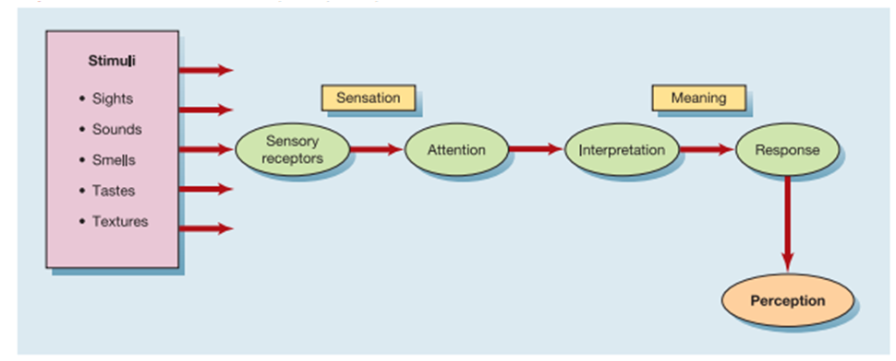
Perceptual Process
https://www.google.com/url?sa=i&url=https%3A%2F%2Faninsightintothemarketingworld.wordpress.com%2F2016%2F03%2F01%2Fthe-perceptual-process.

Slide 4
Emotions in Work Place
Emotions are defined as Physiological, Behavioral, and Psychological Episodes experienced toward an object, person, or event that create a state of readiness.
Emotions are directed toward someone or something. For example, we experience joy, fear.
Emotions are experiences. They represent changes in our Physiological state (e.g., blood pressure, heart rate), Psychological state (e.g., ability to think clearly), and Behavior (e.g. facial expression).
Emotions have a profound effect on almost everything we do in the workplace.

Slide 5
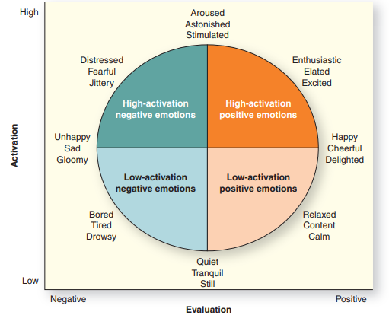
Types of Emotions (Circumflex Model of Emotions):

Slide 6
Enthusiastic (excitement and interest.) | Bored (feeling weary and impatient)
Elated ( Feeling happy) | Tired
Excited(very enthusiastic) | Drowsy (ready to fall asleep)
Happy (showing pleasure) | Unhappy
Cheerful (happy and optimistic) | Sad (feeling or showing sorrow)
Relaxed (free from tension) | Gloomy (partially or totally dark)
Content (state of peaceful happiness) | Distressed (suffering from extreme anxiety)
Calm(not showing or feeling nervousness, other strong emotions) | Fearful (showing fear or anxiety)
Quiet (no noise) | Aroused (to cause someone to have a particular feeling)
Tranquil (free from disturbance) | Astonished (greatly surprised or impressed)
Still (not moving) | Stimulated (raise levels of physiological activity)

Slide 7
Attitudes and Behaviour
Attitudes the cluster of beliefs, assessed feelings, and behavioral intentions toward a person, object, or event (called an attitude object).
Attitudes are judgments, whereas emotions are experiences. In other words, attitudes involve conscious logical reasoning, whereas emotions operate as events, usually without our awareness.
In other words, attitude is the process involving three cognitive components namely beliefs, feelings and behavioral intentions.

Slide 8
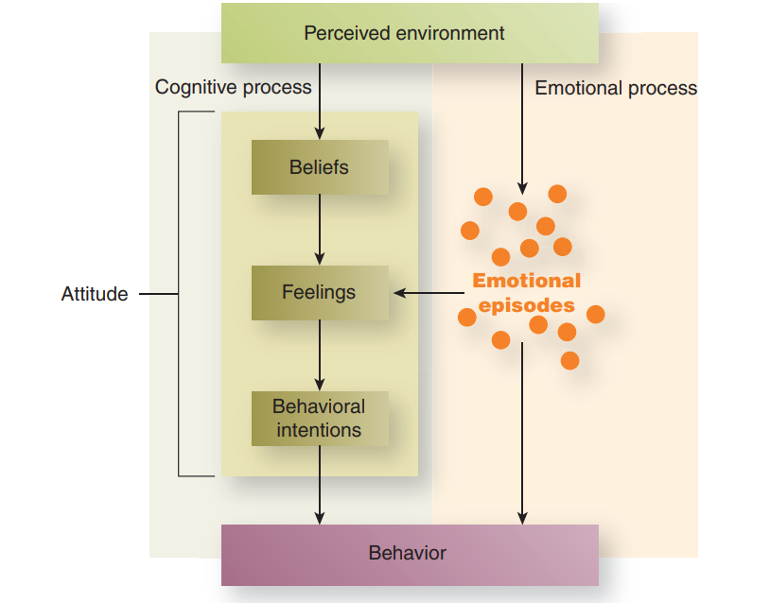
Model of Emotions, Attitudes and Behavior

Slide 9
Work-related Stress and its Management.
https://www.unssc.org/news-and-insights/blog/work-related-stress-and-how-it-can-be-managed.
1.Task demands.
2.Role demands.
3.Interpersonal demands.
4.Physical demands.
5.Workload.
6.Work-Home Conflict.

